Slide 1

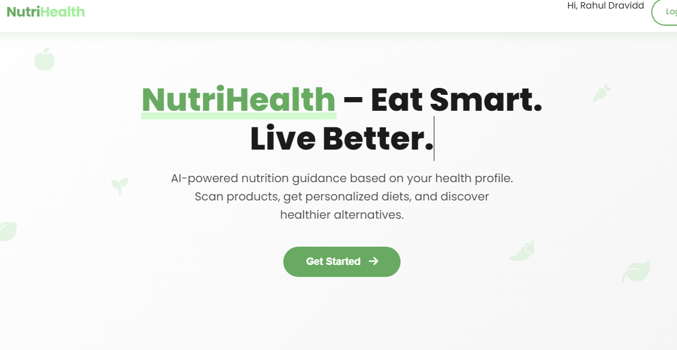
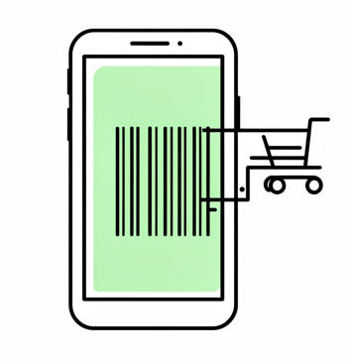
NutriHealth: Nutrition & Food Awareness Platform
SDG 12 – Responsible Consumption and Production
NutriHealth is an innovative Django-based web application that empowers users to make informed dietary choices through intelligent food analysis and personalised nutrition guidance. By combining barcode scanning technology with comprehensive health profiling, the platform analyzes packaged foods, provides detailed nutritional information, and recommends suitable alternatives based on individual health conditions such as diabetes, obesity, and allergies.
Core Mission
Promoting healthy eating habits, reducing food wastage, and supporting responsible consumption aligned with SDG Goal 12
Team Members
  Kavish Batavia (SYCM2-36)
  Keval Gohil (SYCM2-38)
  Omkar Gorule (SYCM2-39)

Slide 2


Problem Statement & Motivation
Problem Statement
  Lack of awareness about nutritional value of packaged food
  Health issues due to improper dietary choices
  Increase in food wastage
  No unified platform for nutrition guidance
Motivation
  Address real-world health challenges
  Encourage responsible consumption
  Reduce food wastage
  Support SDG 12 – Responsible Consumption and Production

Slide 3
Technical Overview
NutriHealth is built upon a robust Django framework, implementing the Model–View–Template (MVT) architecture pattern. The system integrates secure user authentication, comprehensive profile management, and real-time food data retrieval through the Open Food Facts API.
Health Profile
Barcode Scan
Product Analysis
Stores user health and dietary data
Scans food product QR/barcodes
Evaluates nutrition and safety
Diet Plan
Alternatives
Donate
Generates personalized meal plans
Suggests healthier food options
Enables surplus food donation

Slide 4
Implementation Highlights
Backend Implementation
  Developed using Django following the Model–View–Template (MVT) architecture for clear separation of logic, data, and UI
  Implements secure user authentication using Django’s built-in authentication system
  Uses Django ORM to perform database operations efficiently without writing raw SQL
  Ensures scalability, maintainability, and structured backend workflow
Data Handling
  Each user has a unique health profile linked to their account for personalized analysis
  Food and nutrition data is fetched in real time using the Open Food Facts API
  Barcode scan details are stored as scan history for tracking user food consumption
  Structured data storage enables fast retrieval and accurate recommendations

Slide 5
Technologies Used
Backend
  Python – Core programming language for application logic
  Django – Web framework used for backend development, security, and scalability
Frontend
  HTML – Structure and layout of web pages
  CSS – Styling and responsive design
  Bootstrap – Ensures a clean, mobile-friendly user interface
Database
  SQLite –Lightweight relational database used for storing user, health, and food data
  Provides fast access and seamless integration with Django ORM
APIs & Tools
  Open Food Facts API – Retrieves real-time nutritional and product information
  Django Admin Panel – Manages users, scan history, and database records
  VS Code – Development environment

Slide 6
Future Scope & Conclusion
Future Scope
AI/ML-based diet recommendations
  Intelligent algorithms can be used to analyze user health data and food habits to provide more accurate and personalized diet suggestions.
Mobile application development
  The platform can be extended into a mobile app for easier access, real-time barcode scanning, and better user engagement.
Conclusion
  NutriHealth is a practical Django-based solution that promotes healthy eating, reduces food wastage, and supports sustainable consumption. The project demonstrates effective use of modern web technologies to solve real-world health problems.

